Slide 1
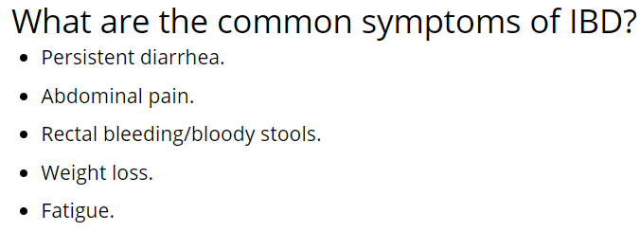
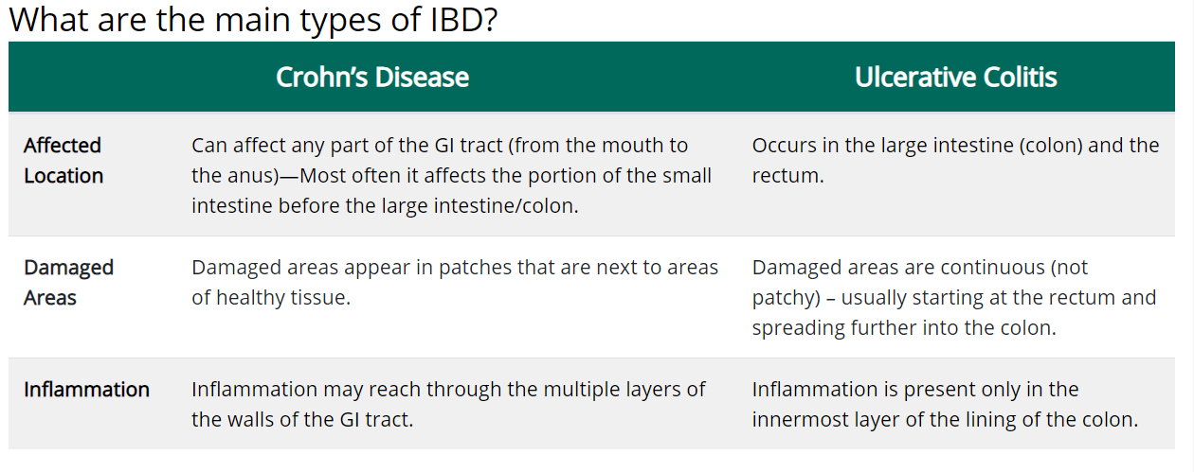
IBD
Inflammatory bowel disease (IBD) is a term for two conditions (Crohn’s disease and ulcerative colitis) that are characterized by chronic inflammation of the gastrointestinal (GI) tract. Prolonged inflammation results in damage to the GI tract.
IBD causes are unknown

Slide 2
RNA Sequence Analysis of IBD and non-IBD patients

Slide 3

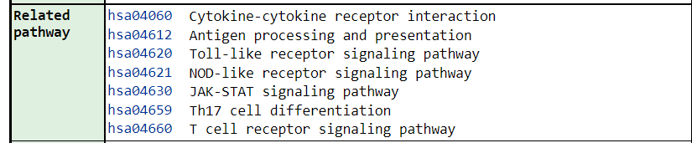
Notes:
There is a pathway called IBD pathway a.k.a. Hsa05321 but interestingly this pathway’s results in pathfindr are pretty low in comparison to other pathways. I mean the p value turns out to be the 21st in the list. Also related pathways are even lower(hsa04612 is not even important according to results.(except jak stat path but it is one of the most crucial path in our system and related to almost everything, so not surprising).

Slide 4
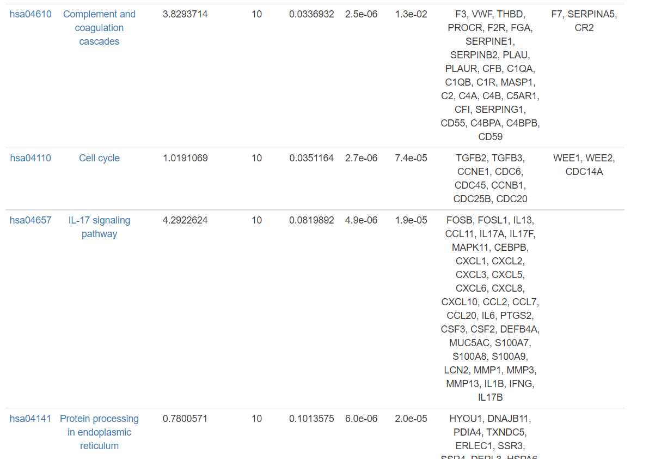
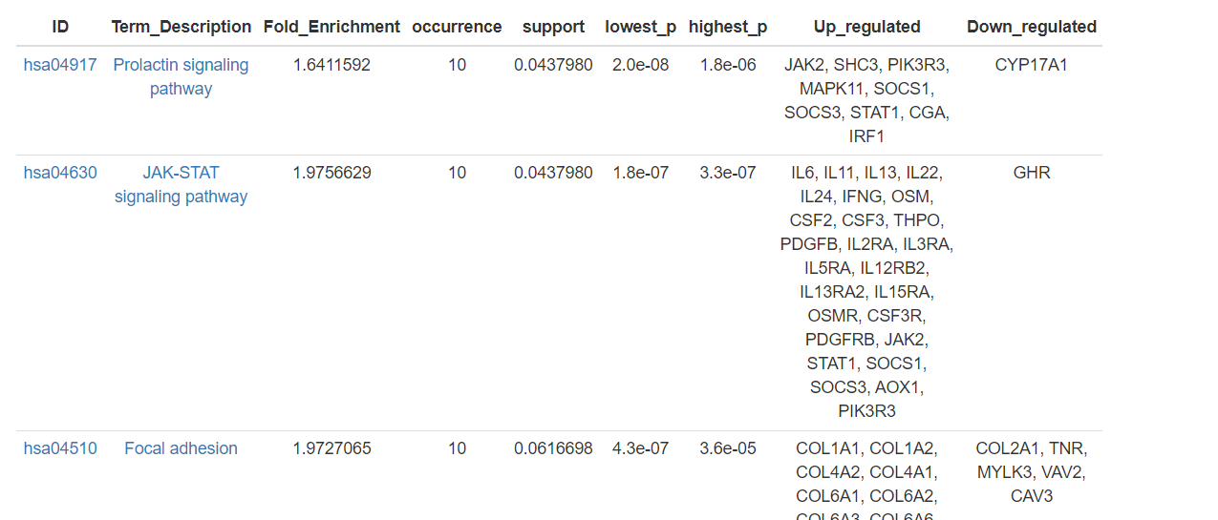
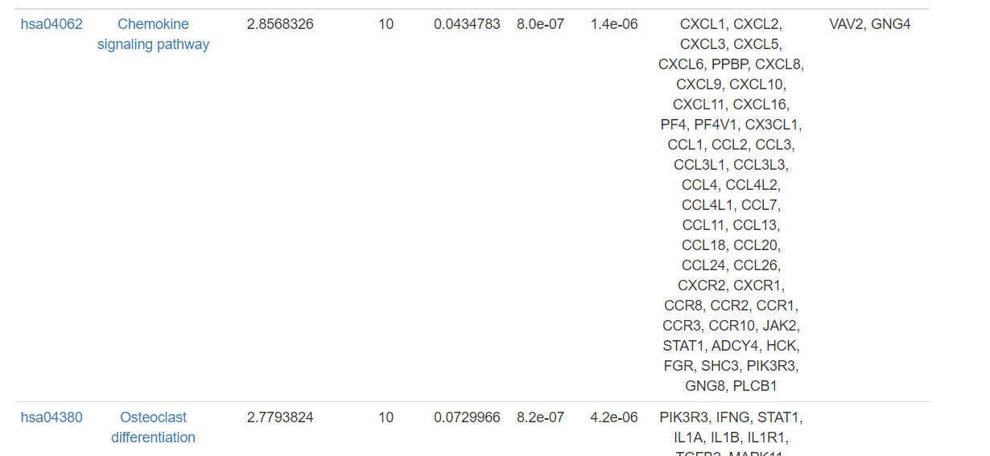
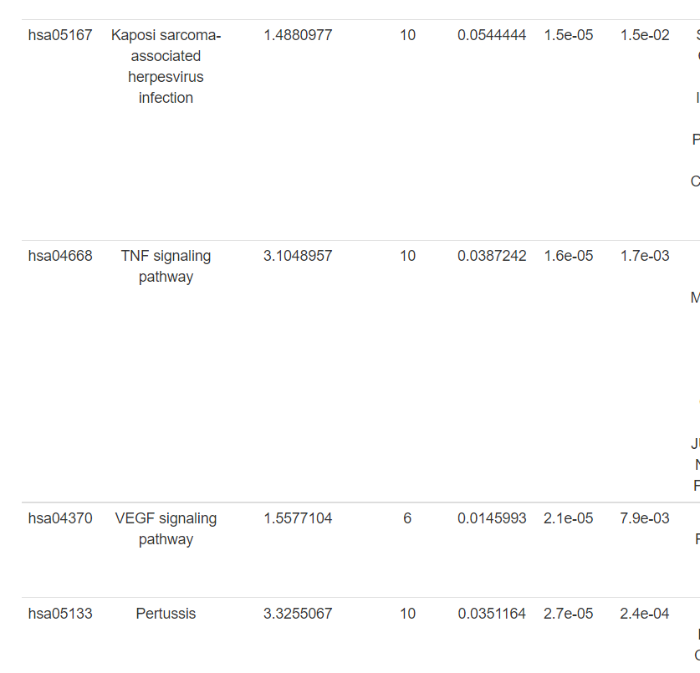
Notes:
That means we are not looking for right things. Most remarkable ones are with the highest fold enrichments with low p values. Such as Chemokine signalling path – Osteoclast differantiation – complement and coagulation cascades - IL 17 signaling – TNF singaling.

Slide 5
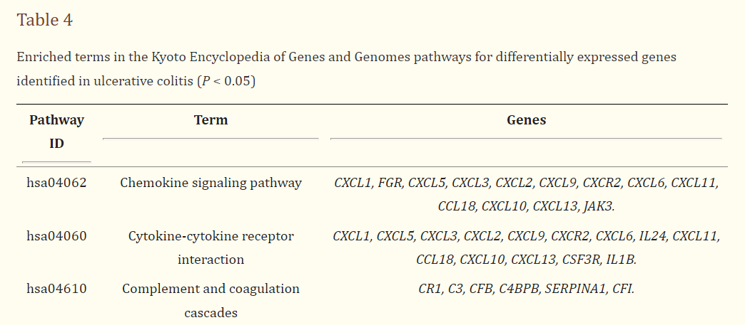
Chemokine Signalling Pathway & Complement and coagulation cascades Pathway
Shi L, Han X, Li JX, Liao YT, Kou FS, Wang ZB, Shi R, Zhao XJ, Sun ZM, Hao Y. Identification of differentially expressed genes in ulcerative colitis and verification in a colitis mouse model by bioinformatics analyses. World J Gastroenterol. 2020 Oct 21;26(39):5983-5996. doi: 10.3748/wjg.v26.i39.5983. PMID: 33132649; PMCID: PMC7584051.
In 2020 research, a relation is also found btw ulcerative collitis and these Pathways.

Slide 6
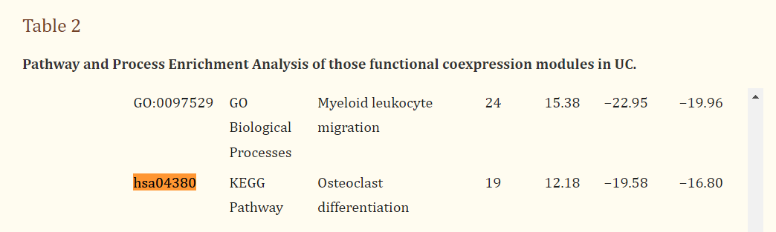
Osteoclast Differantiation
Zhu J, Wang Z, Chen F, Liu C. Identification of genes and functional coexpression modules closely related to ulcerative colitis by gene datasets analysis. PeerJ. 2019 Nov 13;7:e8061. doi: 10.7717/peerj.8061. PMID: 31741804; PMCID: PMC6858811.
In 2019, the relationship also founded

Slide 7
IL 17 signaling Pathway
https://www.nature.com/articles/s41598-022-09559-1
The article in the link has been published in april 2022 and says that IBD is caused by this pathway
TNF signaling Pathway
https://www.ncbi.nlm.nih.gov/pmc/articles/PMC7475943/
Notes:
Non of these pathways are officialy conducted to IBD in KEGG pathway database. But all 5 results have been discussed before and have also been approved by other authorities. That increases our results’ reliability.

Slide 8
Metabolomics Analysis of IBD and non-IBD patients

Slide 9
Steps
Grouping (6 groups of UC – CD – nonIBD for male and females) are reduced into IBD and nonIBD
Normalization
Test results

Slide 10
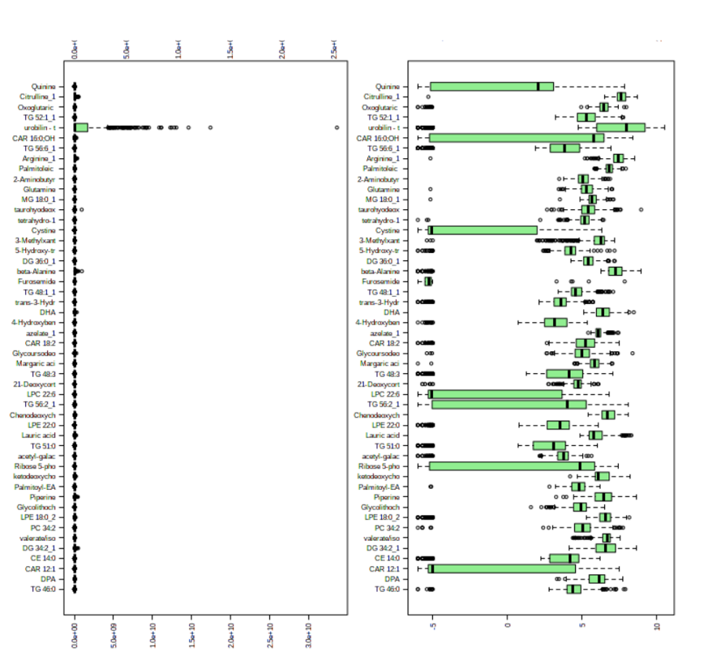
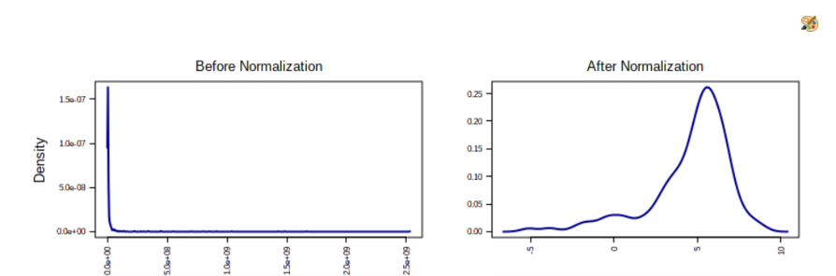

Slide 11
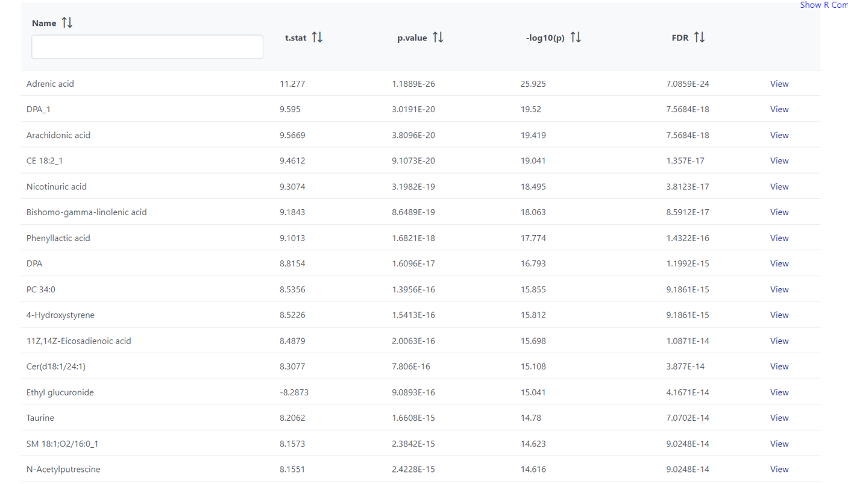
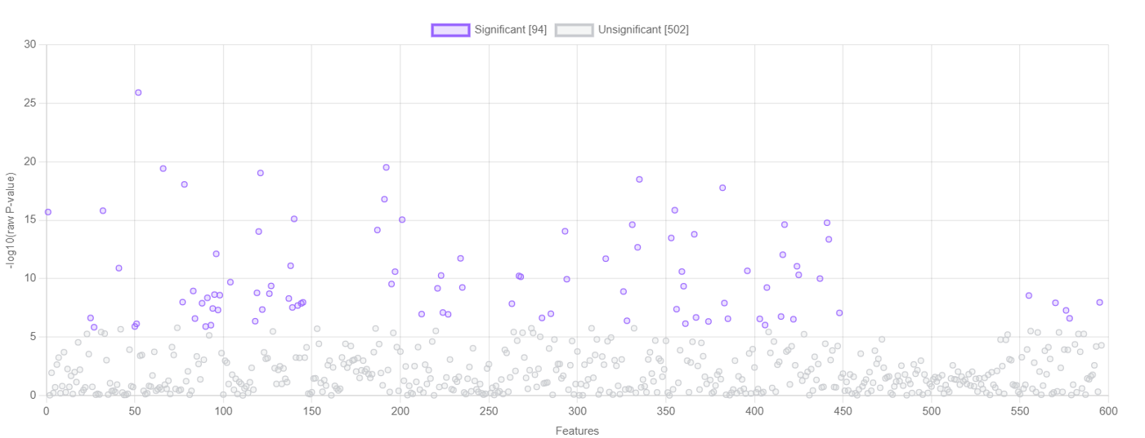
T test results

Slide 12
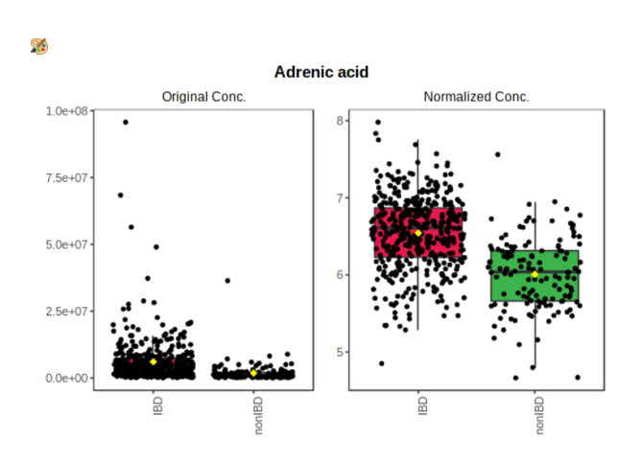
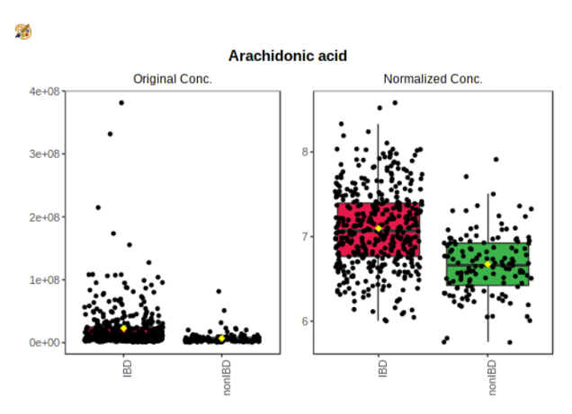
Adrenic acid and arachidonic acid are omega 6 fatty acids
Increased levels of ω6-related oxylipins and decreased levels of ω3-related eCBs are associated with the debut of UC.
(https://www.ncbi.nlm.nih.gov/pmc/articles/PMC6801729/ )
Notes:
Couldnt find any function of dpa1

Slide 13
Nicotuniric acid
In this study, we investigated the therapeutic effect of niacin on colitis both in mice and in patients with moderately active UC. We found that niacin shows anti‐inflammatory and anti‐apoptotic properties through downregulation of colonic inflammatory cytokine levels, suppression of vascular permeability, and inhibition of colonic epithelium apoptosis by activation of DP1 receptor in macrophages, endothelial cells, and colonic epithelium. Furthermore, treatment with retention enema containing niacin effectively promoted clinical remission and mucosal healing in patients with moderately active UC.
https://www.ncbi.nlm.nih.gov/pmc/articles/PMC5412792/

Slide 14
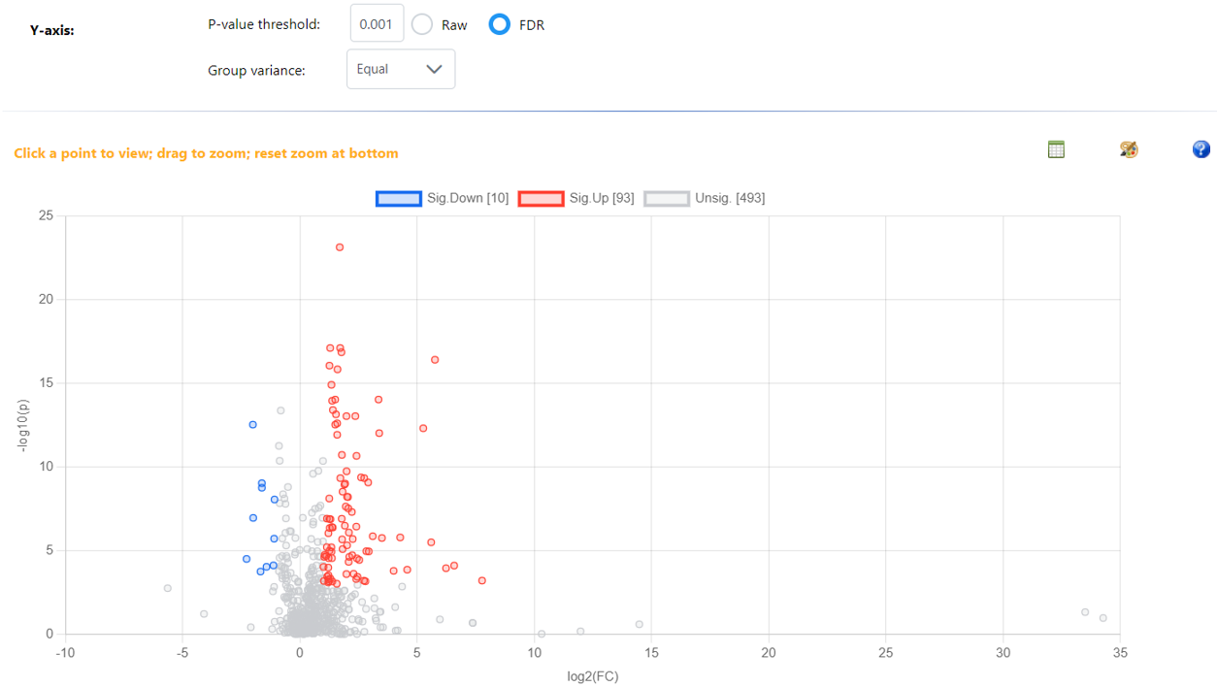

Slide 15
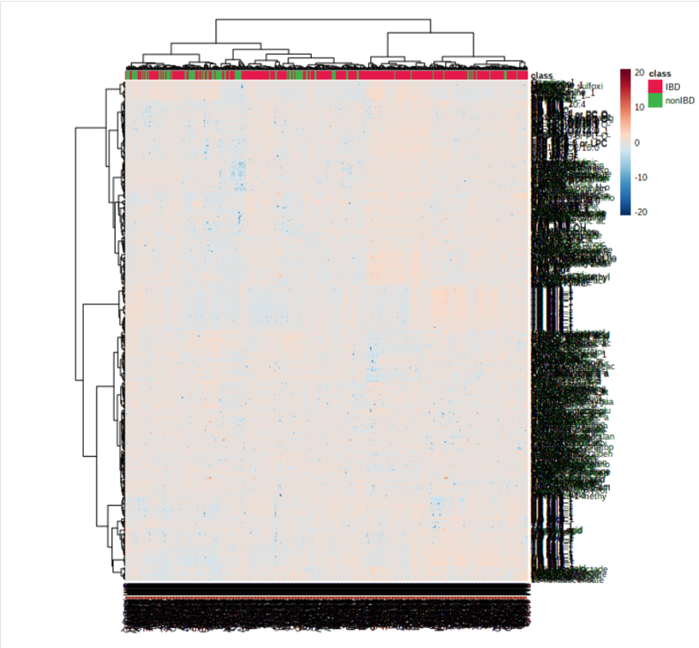
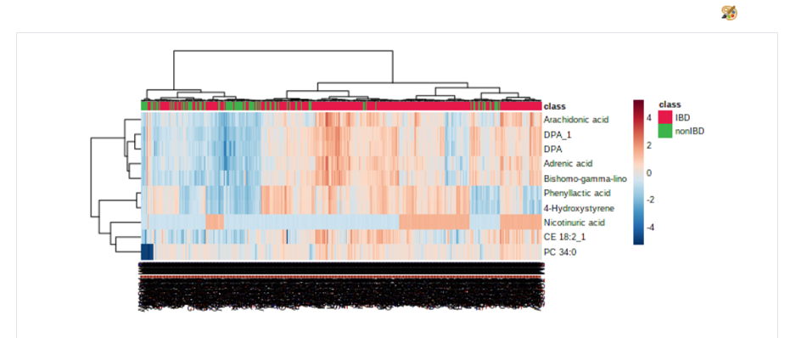

Slide 16
Thanks For Your Attention
Celaleddin Ömer Sağlam 200600017

